Slide 1


MULTI-PURPOSE DRONE
Chhotubhai Gopalbhai Patel Institute of Technology, Bardoli
Prepared By:
Jenish Madhu (201902100110006)
Pranav Unnithan (201902100110007)
Kathan Master (201902100110018)
Guide :
1.Mr.Bhargav D. Patel
2.Mr. Arjun Jariwala

Slide 2
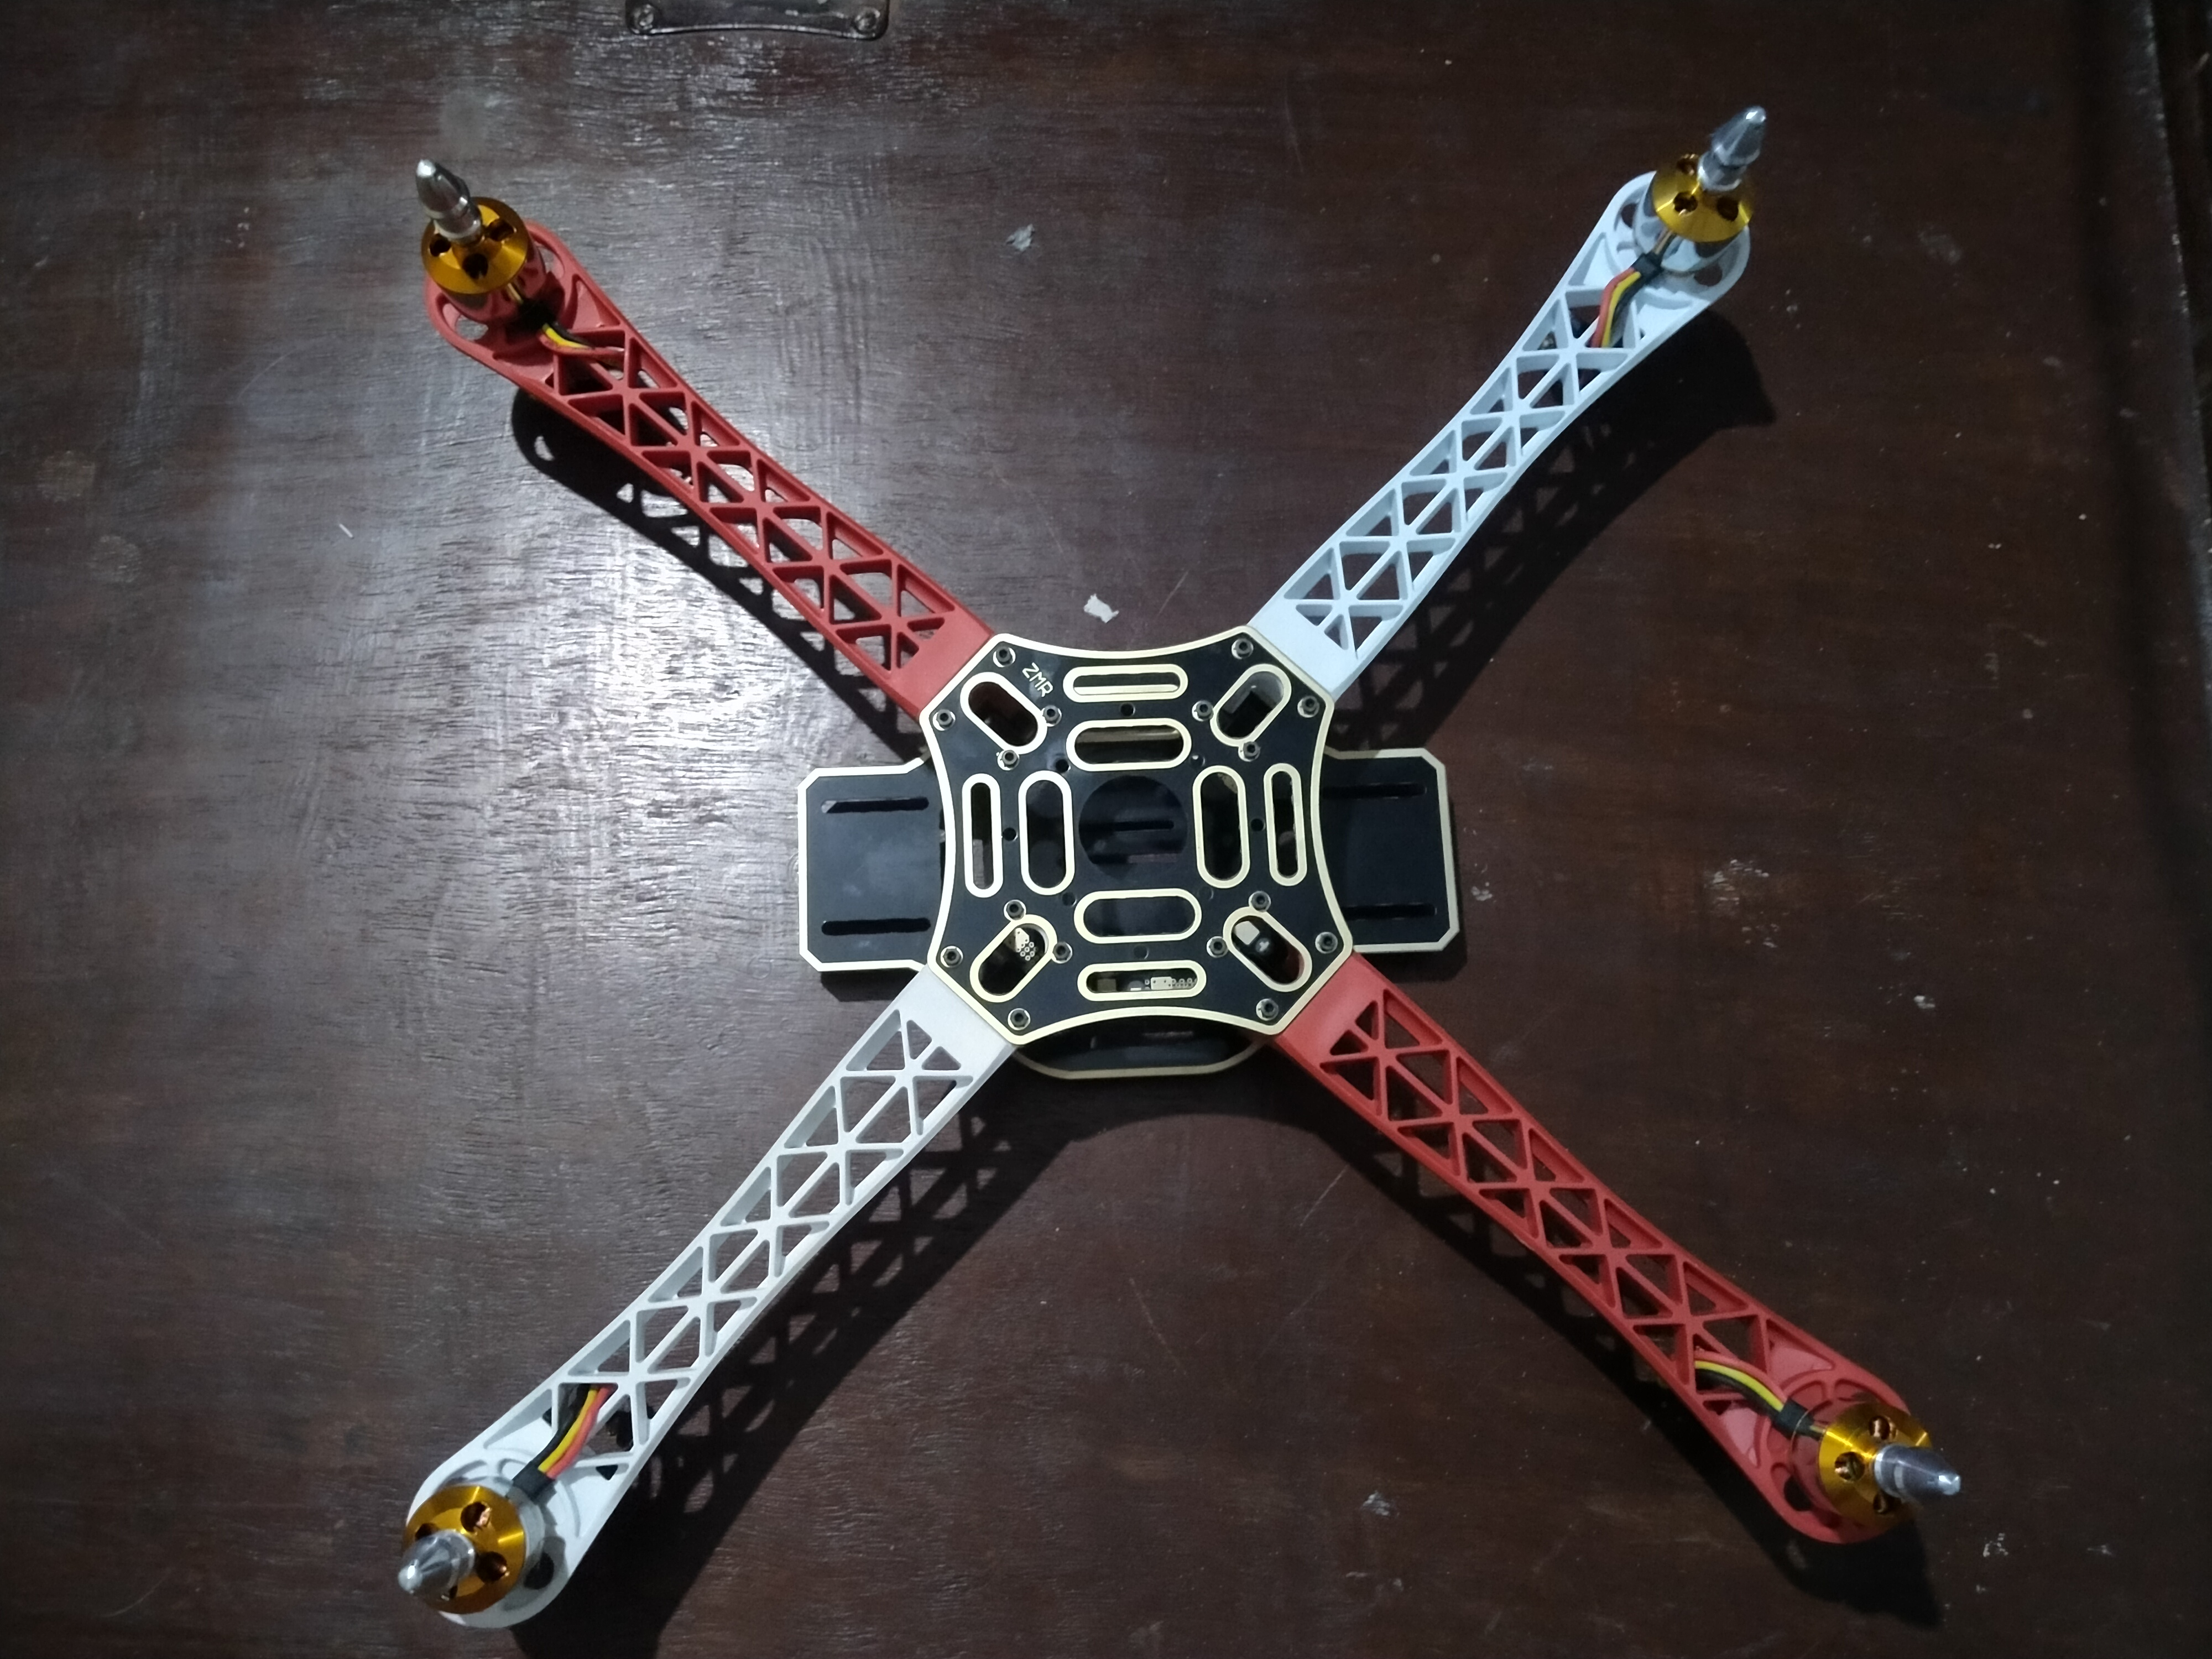
Content
Introduction
Literature Review
Objective of Project
Block Diagram of project
List of Components
Cost Estimation of your project
Future work
References

Slide 3
Introduction
The materials and parts selection have been considered based on detailed evaluation of drones available in the market along with the considerable mass of payload to be carried.

Slide 4
Literature Review
1.Multi-Purpose Drone Using IoT, (Srividhya Sekar.C),(International Journal of Advance Research in Science & Engineering),(2019)
2.Autonomus Drone Project. (Abin vaghrsee), (Mr Ajit V Babu)
3.Multi Purpose Drone with Search and Destroy Rover. (Sabitha Gauni),(International Science Press),(2016)

Slide 5
Objective
In this project our main concept is to make a prototype multi-tasking drone using KK2.1 Flight controller which will help us to easy our work like Pesticides the plants in farm, Pick and place the object and photography.

Slide 6
Block diagram of Multi-Purpose Drone
Motor 4
(CCW)
Supply
Signal
ESC 30A
WIFI Camera
5V
GND
Signal
ESC 30A
Motor 3
(CW)
Signal
Receiver
KK2.1 Flight controller
Signal
Motor 2
(CCW)
ESC 30A
Transmitter
Signal
Servo Circuit connected with Relay
Signal
ESC 30A
Motor 1
(CW)
DC Motor Pump connected with Relay
Lipo Battery 11.1V 30C
Supply
Supply

Slide 7
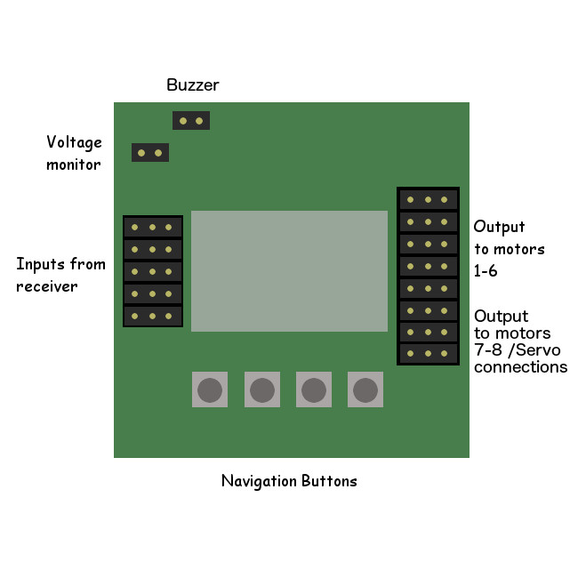
Circuit diagram of Multi-Purpose Drone
Relay with Pump
ESC 30A
M1 (CW)
ESC 30A
M2 (CCW)
+--
CH6
CH5
CH4
CH3
CH2
CH1
Recevier
ALIERON
ELEVATOR
THROUTTLE
RUDDER
AUXILARY
ESC 30A
M3 (CW)
SIGNAL
ESC 30A
M4 (CCW)
ESP 32 CAM
5V
+
_
Battery 11.1V
2200mAh

Slide 8
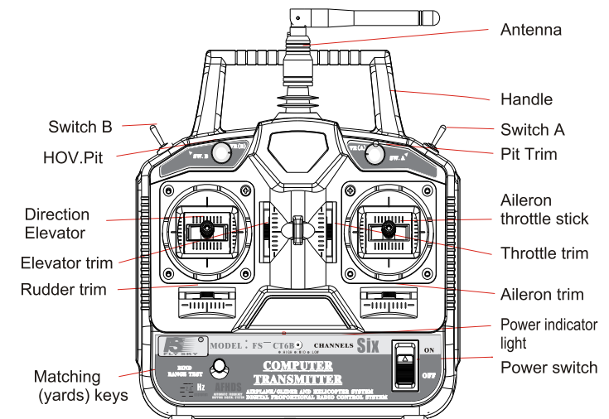
Remote Control Unit

Slide 9
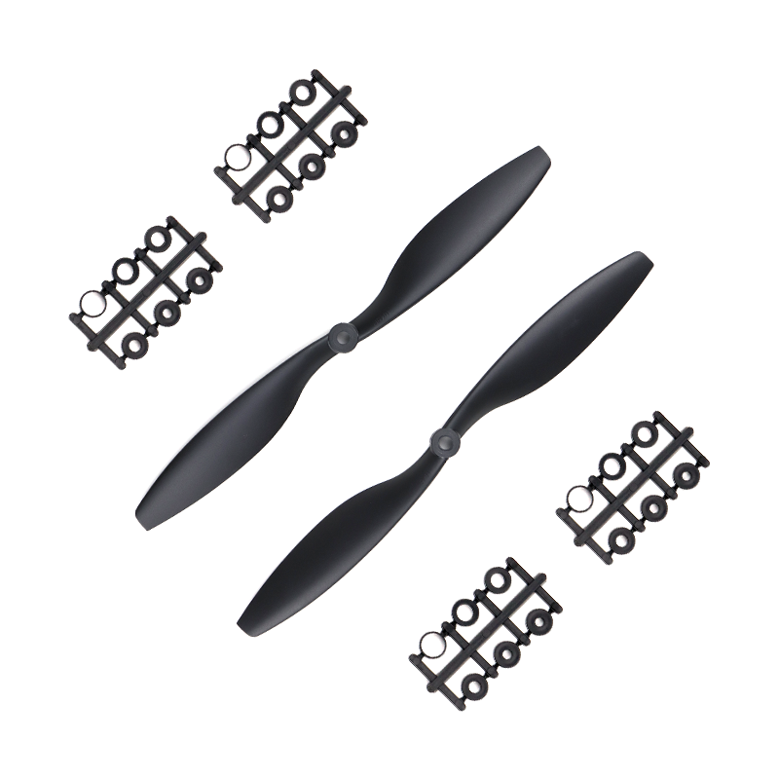
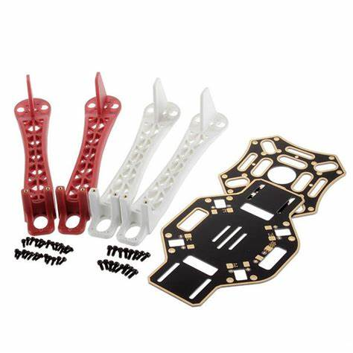
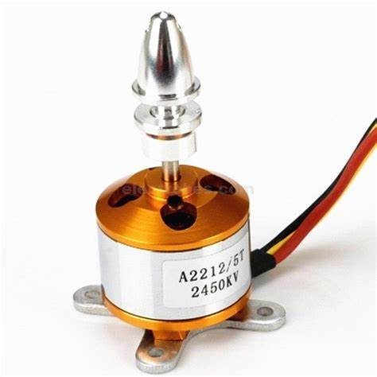
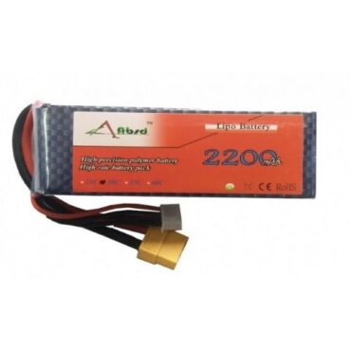
List of Components
1. Propeller Pair 10*4.5 Inch
2. Quadcopter Frame 4-Axis- Integrated PCB Wiring (F450)
3. BLDC Brushless Motor (2450KV)
4. 11.1V - 2200mAh LiPo Rechargeable Battery- 30C

Slide 10
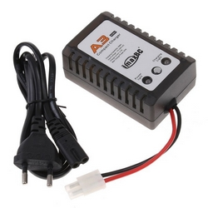
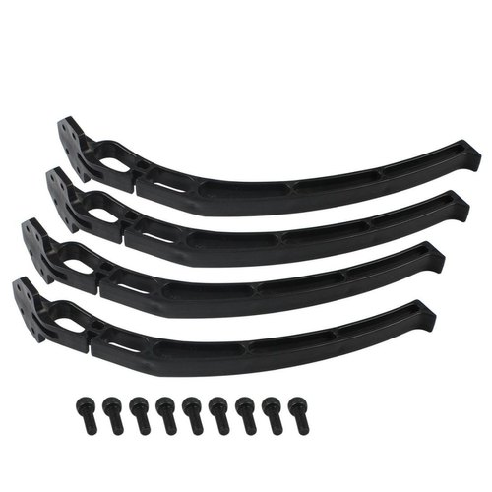
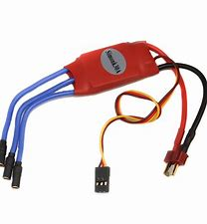
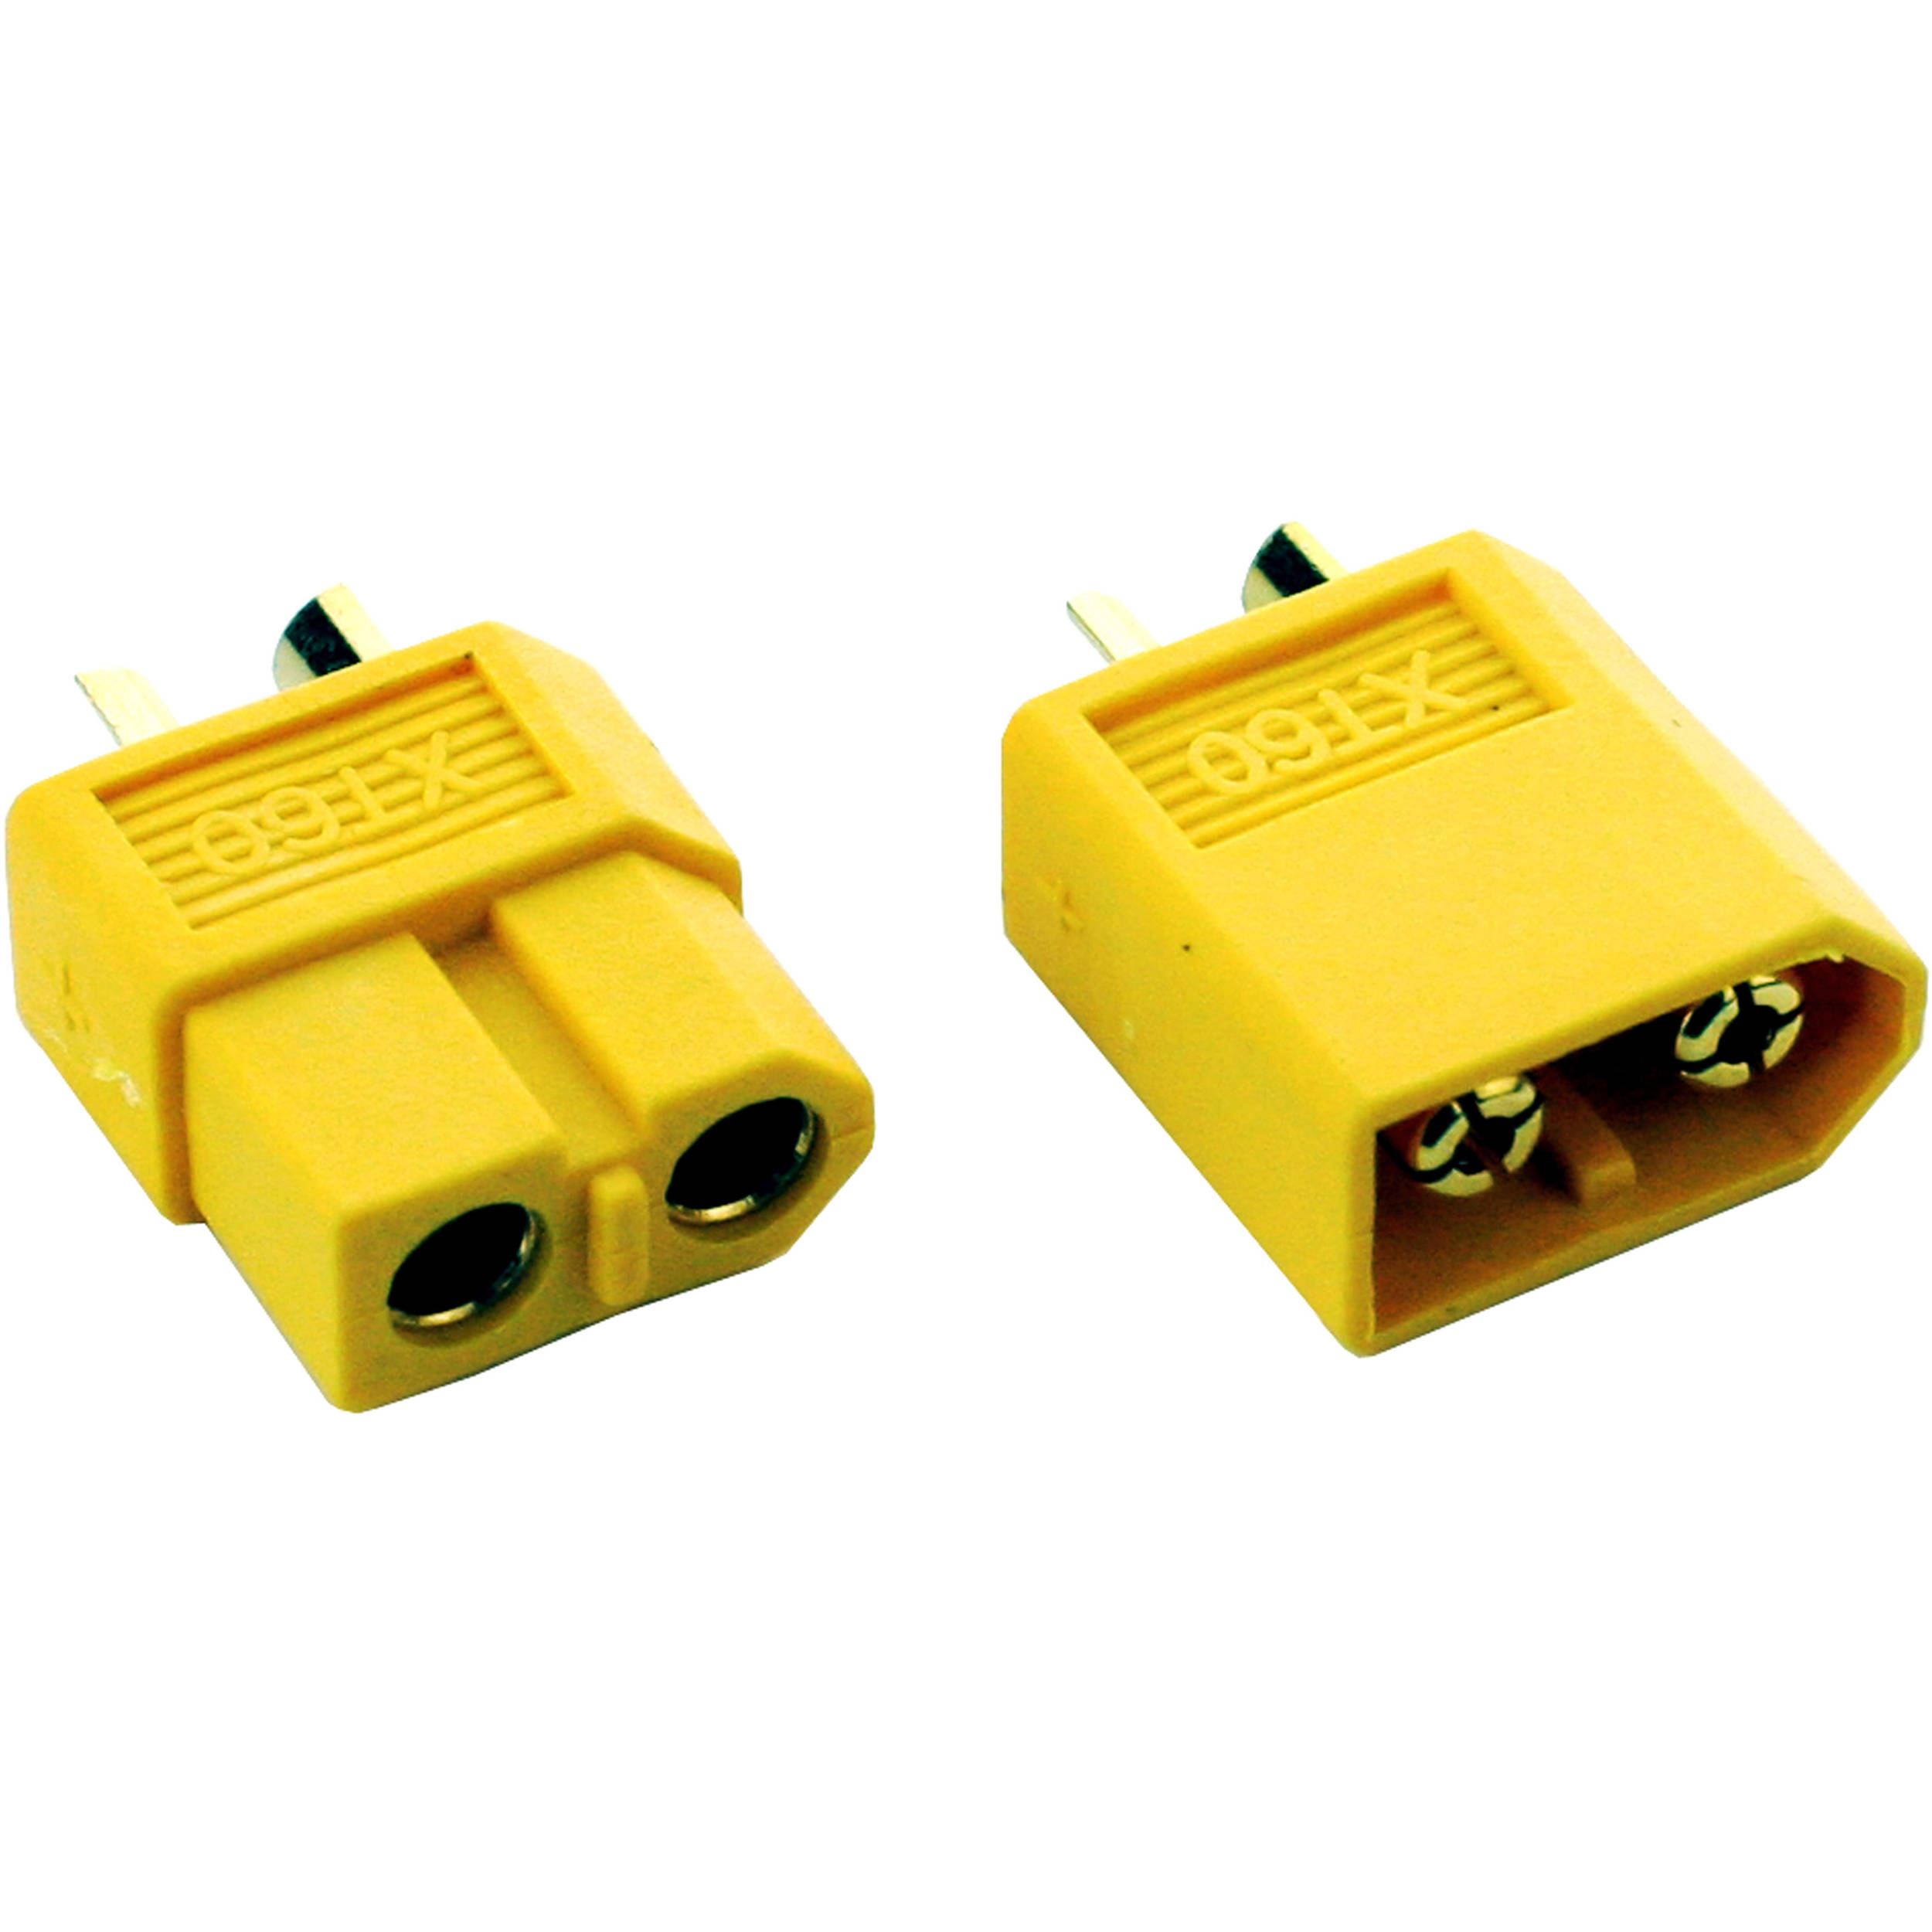
5. B3 Lithium Polymer (LiPo) Battery Charger for 2S-3S LiPo
6. Landing Gear
7. ESC30A
8. XT60

Slide 11
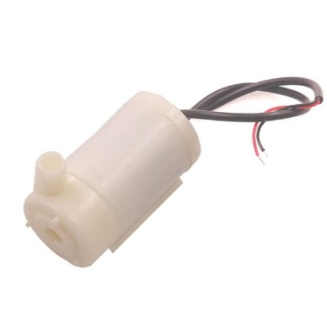
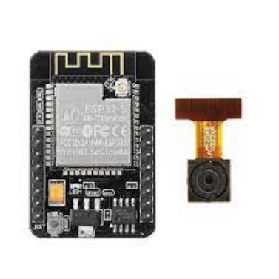
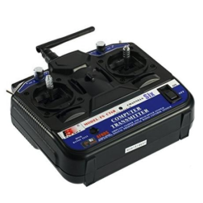
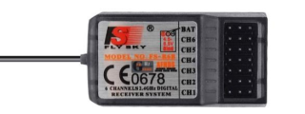
9. Water Pump
11. ESP- 32 Cam
12. FS-CT6B(Remote controller with Receiver)

Slide 12
Cost Estimation
Sr.no | Product | Quantity | Price(RS)
1. | Propeller Pair 10*4.5 Inch | 2 | 65
2. | Quadcopter Frame 4-Axis- Integrated PCB Wiring | 1 | 590
3. | BLDC Brushless Motor | 4 | 330
4. | 11.1V - 2200mAh LiPo Rechargeable Battery- 30C | 1 | 1075
5. | B3 Lithium Polymer (LiPo) Battery Charger for 2S-3S LiPo | 1 | 425
6. | Landing Gear | 1 | 300
7. | ESC30A | 4 | 1600
8. | XT60 | 1 | 50
9. | DC Water Pump | 1 | 125

Slide 13
Cost Estimation
Sr no. | Product | Quantity | Price
10. | Relay | 1 | 100
11. | FS-CT6B Remote controller with Receiver) | 1 | 2500
12. | ESP- 32 CAM | 1 | 600
13. | Servo Motor | 2 | 100
14. | Jumper Wire | 1 | 20
15. | KK 2.1 Flight Controller | 1 | 2000
The total cost of project is Rs15000/-.

Slide 14
FUTURE Work
Pick and Place

Slide 15
THANKYOU

